Slide 1
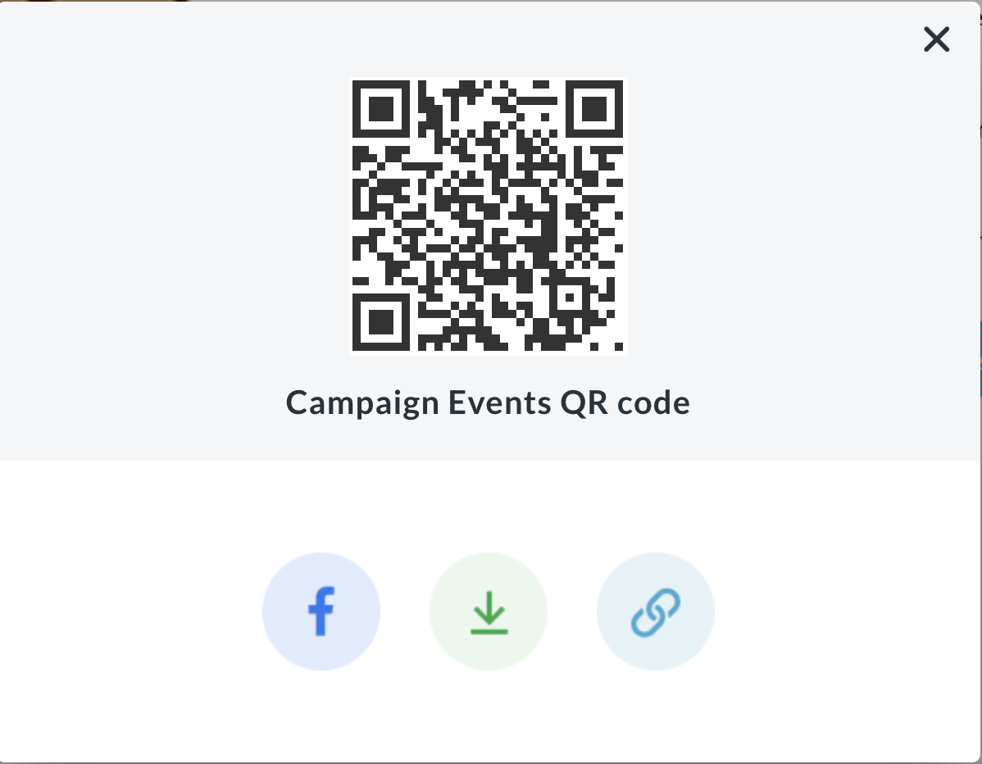
TEMPLATE INSTRUCTIONS
Go to your team or personal fundraising page to download the QR code that will send donors to that page.
Click on the “Share” button and then click the down arrow icon to download the “QR” code.
On the next slide replace the QR code with the one you downloaded
Now print your Scan & Donate file!
Tak it with you to the event and display it so donors can scan the QR code with their phone and make a donation to you and/or your team!

Slide 2
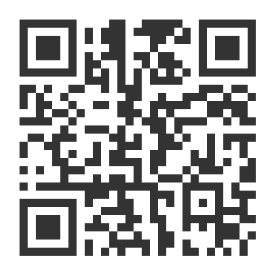
SCAN &
DONATE
LET’S FIGHT HUNGER TOGETHER

